Slide 1
Reporting Guidance

Slide 2
Context – why we report
PMU: Performance Measurement Update → PMU5 = Environment
Sustainability Data Manager:
Manage the Environment Reporting Process (PMU5 data) & Sustainability Tool
Gemma Bailey-Smith
Sustainability Tool:
Web-platform developed by Action Sustainability
Collect Environment (monthly) and Social data (quarterly) from EKFB Supply Chain
Sustainability tool team: Env team + Social (Equality, Diversity, Inclusion) team + Supply Chain Team

Slide 3
I. Context: Requirements & Performance measure
Contractual requirement
Performance Monitoring
Assurance we are doing our jobs
Client; Parent Companies; EA;
Other stakeholders
Monitor progress to EKFB commitments
(tender, plans, strategies etc.)
Client commitments
HS2 commitment to UK government (HS2 Act); U&A’s; Benefits Management (economic and social value: Engine for Growth); etc.
Compliance with other requirements
Legal: ESOS; Waste etc.
Measure performance
Continuous improvement
Always looking to improve
Parent companies
Sustainability Strategies; Carbon commitments; etc.

Slide 4
II. Environment Reporting Process: 4 sub-processes
Onboarding Process
Reporting Process
Approving Process
HS2 Reporting Process
Tradex Onboarding & Activation form
Collection planning & Automatic query
Notification
Global review
Sustainability Tool Onboarding
Reporting to EKFB
Report Review, and Approval/Rejection
Horace submission
HS2 Review
Training & Supply Chain School
Follow-up with potential late submissions
Report Rejected
Report Approved
Report Rejected
Report Approved
People involved
Data sent to internal reports (Dashboard, etc.) and parent companies
Supply Chain Team
Subcontractor/supplier
Sustainability Data Manager
Subcontractor/supplier
Sustainability Data Manager
Subcontractor/supplier
Section Environment team (approvers)
Sustainability Data Manager
Sustainability Data
Manager
HS2 Environment team

Slide 5






III. How do we collect our data? Report structure
3 categories of contractors
Supplier* | Subcontractor | Supplier-subcontractor
2 types of reports
Routewide report Checked by Sustainability Data Manager
Section report Checked by Section Environment team (approvers)
N/A
*Some Fuel and Water suppliers are unable to report at a section level, so an exception has been made for them to report their data in a Routewide report

Slide 6
IV. What environment data do we collect on the tool?
Route wide Report
Checked by Sustainability Data Manager
Section Report
Checked by Section Env team (approvers)
Amount of concrete, timber, steel, and aggregates (“other”) delivered
Steel cost from UK sources
Responsible sourcing certificates
Material Location (asset and activity ID)
Amount of waste managed (if waste management is pending, not reported)
Waste route, waste type and waste categories (construction, demolition, timber, excavation)
WTN, WCN, when applicable
>25% of Aggregates responsibly sourced
100% of Timber responsibly sourced
100% of Concrete responsibly sourced
100% of Steel responsibly sourced
100% of Steel price coming from UK sources
95% of Construction waste diverted from landfill
95% of Demolition waste diverted from landfill
95% of Excavation waste diverted from landfill
95% of Timber waste beneficially reused
Amount of water delivered
Water source (abstracted, raw or potable)
N/A (but minimise the use of potable water for the works)
Number of best practice, good news, innovations
N/A
Number of Full time and part time employees]
Number of hours worked
N/A
Amount of fuel and electricity supplied (or self-supplied)
N/A
Metric
Target

Slide 7
V. Roles & Responsibilities matrix
Section Report
Role | Responsible | Responsibilities
Data Reporter | Subcontractor or Supplier | Data, Submitting report, Comply with reporting deadline Answer Data approver queries
Data Approver | Section Environment team | Approving report, Comply with reviewing deadline Data consistency and quality (evidence checking) Raise any identified inconsistencies to Data Administrator (Email or internal report)
Data Administrator | Sustainability Data Manager | Ensure Sustainability Tool runs properly Onboard Reporter and approver on the tool Support approver in their strategy to review reports Follow-up late submissions or answered queries

Slide 8
V. Roles & Responsibilities matrix
Route wide Report
Role | Responsible | Responsibilities
Data Reporter | Subcontractor or Supplier | Data, Data submission, Compliance with reporting deadline Answer Data approver queries
Data Approver | Sustainability Data Manager | Data approving, Compliance with reviewing deadline Data consistency, and quality (evidence)
Data Administrator | Sustainability Data Manager | Ensure Sustainability Tool runs properly Onboard Reporter and approver on the tool Assist approver in their strategy to review reports

Slide 9
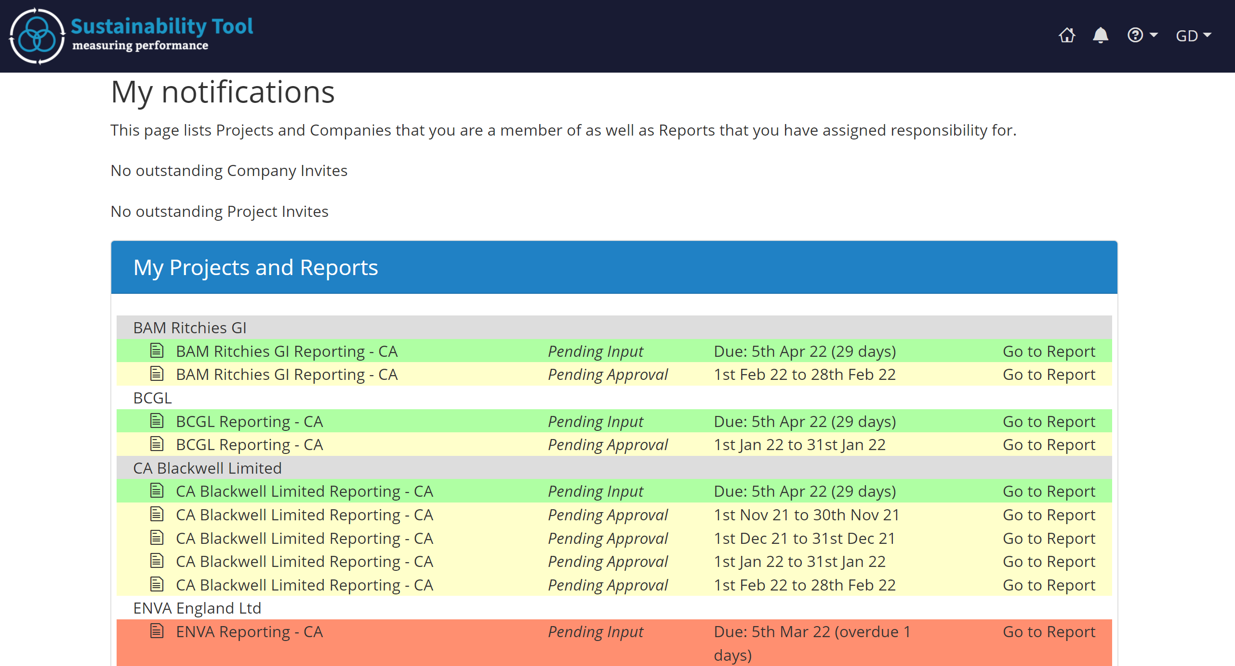
Main page: Notification page This page displays all the “non-approved” reports, and allows you to access them quickly
VII. "How To"
5 colour codes:
Pending Input: Late pending submission
Pending Input: Pending submission, deadline in less than a week
Pending Input: Pending submission, but in a more than a week
Pending Approval: Submission done, ready to be reviewed
Requires Revision: Submission done, but rejected. Pending re-submission with amendments

Slide 10
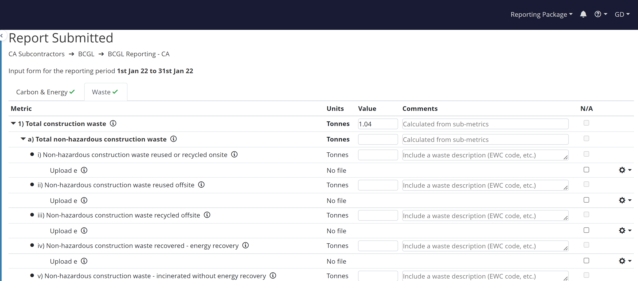
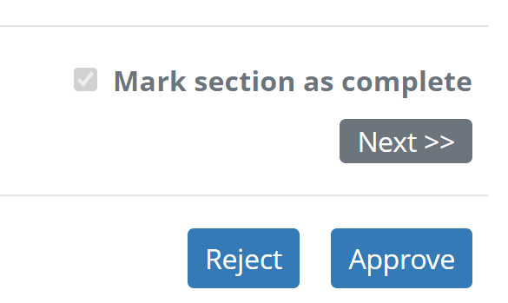
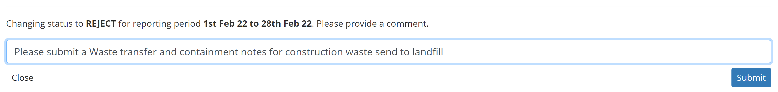
Report page This page shows the data submitted and allows you to approve or reject the report
VII. "How To"
Subcontractor
Report date
2
1
Bottom right of the report
3
4
5
Automatic email sent to the reporter with both the comment and a direct link to the report

Slide 11
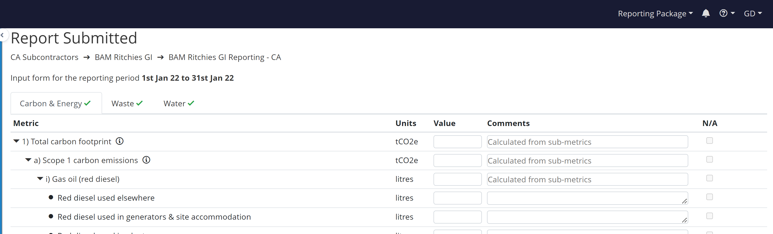
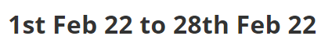
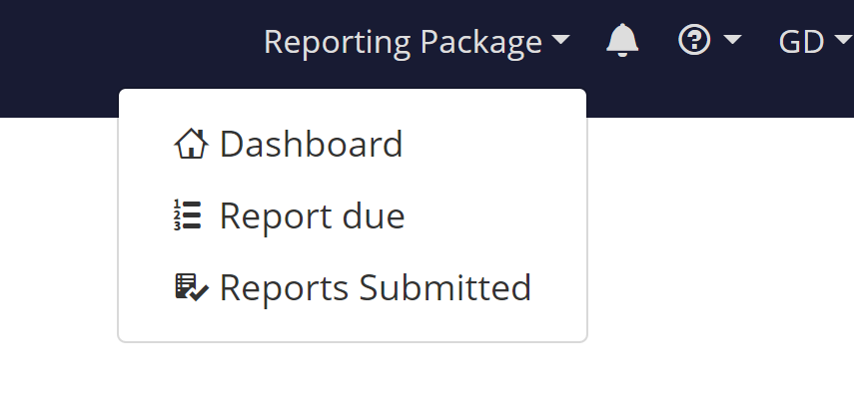
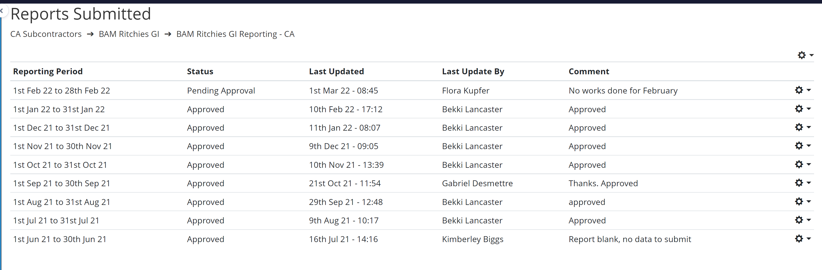
“Submitted Reports” page This page displays all the submitted report so far
VII. "How To"
1
2
3
4

Slide 12
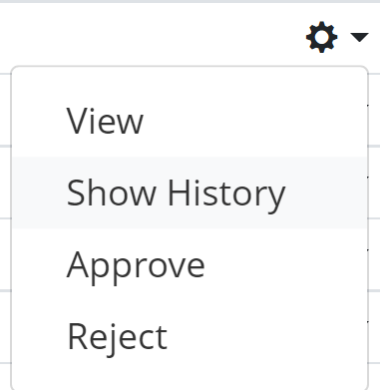
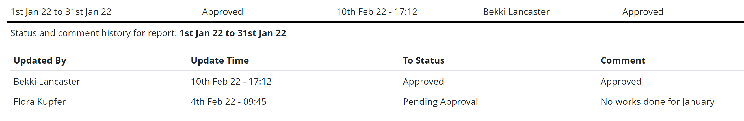
Show history of a report On the “Submitted Reports” page, you can also see the submission history of a report
VII. "How To"
1
2
3

Slide 13
VIII. 2022 Calendar
Reporting Month | Subcontractors/supplier deadline (Submission to EKFB)*
January 2022 | 5th Jan
February 2022 | 4th Feb
March 2022 | 4th Mar
April 2022 | 5th Apr
May 2022 | 5th May
June 2022 | 3rd Jun
July 2022 | 5th Jul
August 2022 | 5th Aug
September 2022 | 5th Sep
October 2022 | 5th Oct
November 2022 | 4th Nov
December 2022** | 5th Dec
* Subcontractors/suppliers submit their data on the 5th of the month, or the last working day before it
** December deadline being tight every year, specific exceptions can be made to allow enough time for the supply chain to collect their data

Slide 14
X. Troubleshooting Unfortunately technical issues happen quite often on the tool, please refer to the below if you encounter one
If you’re experiencing an issue with the tool, first try to refresh the page or close and re-open your browser.
If the issue persists, inform the Sustainability Reporting Team sustainabilityreporting@ekfb.com so they can send a query to the IT Support team from our subcontractor Action Sustainability
The key information being :
The report in question you’re having issue with
A screenshot of your issue
A brief description of your issue

Slide 15

Summary
EKFB Supply Chain submit their reports one the 5th of the month
The Sustainability Data Manager administrates the Sustainability tool, onboard the subcontractors reporters and submit the final report to HS2 Environment team
Materials data are reported Route wide ; Waste, Water and Fuel are reported at a section level (with some exception for some fuel and water suppliers)
Any question: Drop a message to the Sustainability Reporting Team sustainabilityreporting@ekfb.com

